Slide 1
CREDIT CARD APPROVAL
1
Ditablan, Gil Jeremy P.
Reyes, John Ramil C.
Tajanlangit, Renzel E.

Slide 2
Group 1
BACKGROUND

Slide 3

Credit Card
Used by the card holders to purchase goods and services that accept cards as payment by borrowing funds from banks or other similar services.

Slide 4




Criteria:
Credit Score
Income
Occupation
Location

Slide 5



Current Situation
In the US payment ecosystem, the pandemic has caused credit card market stats to fall but eventually have seen growth within two years. Credit card growth is continually stabilizing specially when the consumer has embraced e-commerce.
This is also the case in our country where the credit card stats has fallen but eventually continues to rise within the past quarters because of economic revival and the rise in consumer spending.

Slide 6
Group 1
PROBLEM DEFINITION

Slide 7

The main problem is the cost and time when dealing with multiple applications for a credit card that needs to be reviewed and multiple factors or variables that needs to be consider.

Slide 8
Group 1
DATASET

Slide 9
The credit card approval dataset has 690 data entries.

Slide 10
Features | Description | Variable Type | Value
Debt | Amount of applicant’s current debt. | Independent | Numerical range
BankCustomer | If the applicant has a bank account or not. | Independent | 1 (Yes) or 0 (No)
YearsEmployed | Number of years the applicant has been employed. | Independent | Numerical range
Employed | Applicant’s current employment status. | Independent | 1 (Yes) or 0 (No)
CreditScore | A numerical score that depicts the applicant’s worthiness given by the bank. | Independent | Numerical range
Income | Applicant’s Monthly income. | Independent | Numerical range
Approved | Whether the credit card application is approved or rejected. | Dependent | 1 (Yes) or 0 (No)

Slide 11
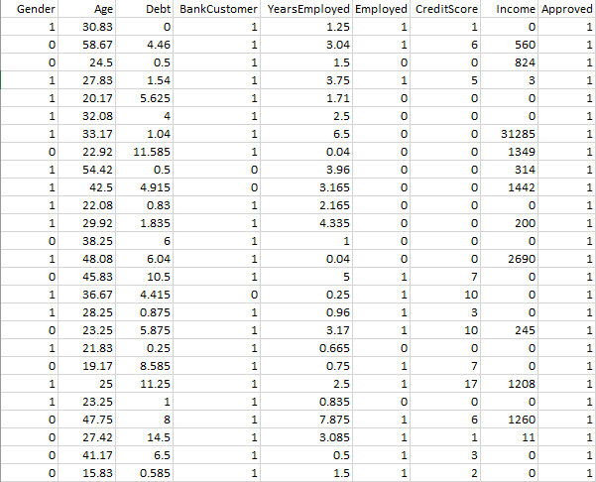

Slide 12
Group 1
SYSTEM ARCHITECTURE

Slide 13


Credit Card Approval Dataset
(CSV Format)
Data Cleaning
(Removing Noisy Data and Filtering Parameters)
Input Dataset
Accuracy
of the system
Dividing Datasets 70:30
(Training and Testing
Dataset)
Naïve Bayes
Algorithm
Output
(Prediction)
SYSTEM
ARCHITECTURE

Slide 14
Group 1
MACHINE LEARNING
ALGORITHM

Slide 15
NAÏVE BAYES
ALGORITHM
Predict the approval of credit card applications
Classify different credit card applications according to their feature value
The feature variables that will be fitted into the Bayesian model are Debt, BankCustomer, YearsEmployed, Employed, CreditScore, and Income

Slide 16
Group 1
PYTHON PROGRAMMING
DISCUSSION

Slide 17
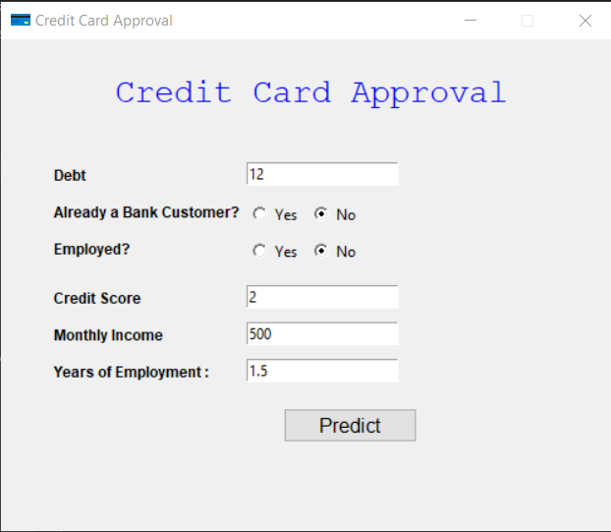
Graphical User
Interface

Slide 18
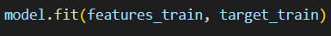
Transformation of data
from Qualitative to Quantitative

Slide 19
Splitting for Training
and Testing
 | Training | Testing
Percentage | 70% | 30%
Quantity | 483 | 207

Slide 20
Modeling based on the Training Set
The developer filtered the parameters of the training datasets into 7 parameters:
6 - independent Variable
1 – Dependent Variable
The developer used
Gaussian Naïve Bayes
because the data sets are numerical and Categorical.
The Developers will feed the dataset into the model to train and test the said model

Slide 21
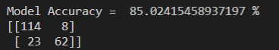
Accuracy of the Model
The Naive Bayes model trained on our dataset got 85.02% of accuracy in predicting approval state of the credit card applications based on the testing dataset.

Slide 22
Simulation with
Test Data

Slide 23
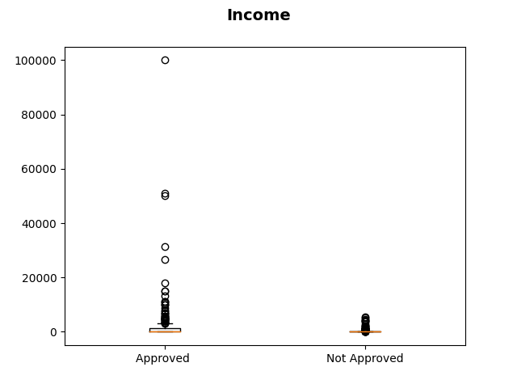
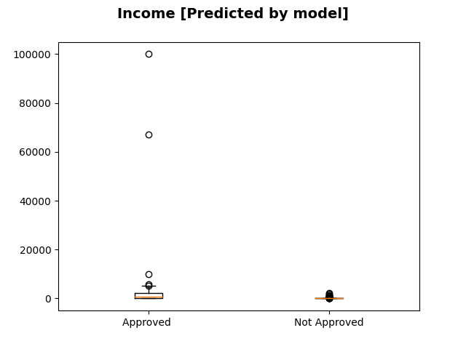
Visualization of the Results
Box Plot (Training Dataset)
Box Plot (Testing Dataset)

Slide 24
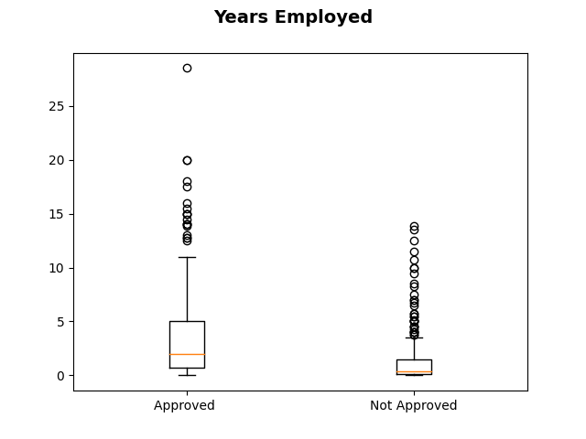
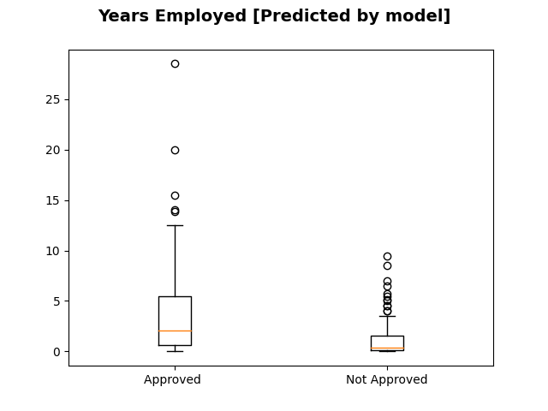
Visualization of the Results
Box Plot (Training Dataset)
Box Plot (Testing Dataset)

Slide 25
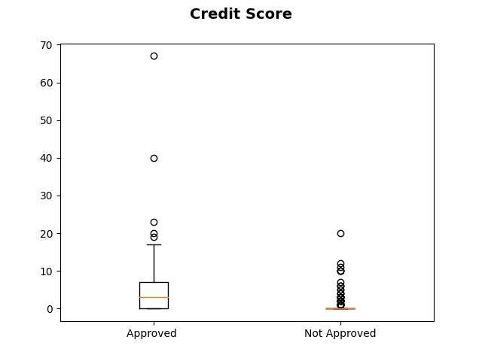
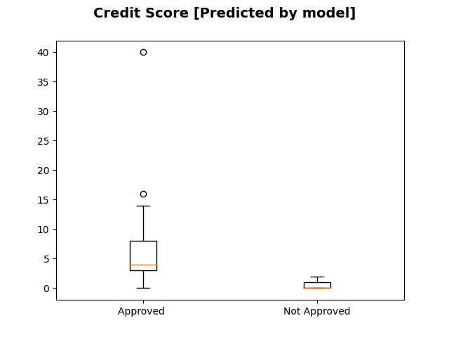
Visualization of the Results
Box Plot (Training Dataset)
Box Plot (Testing Dataset)

Slide 26
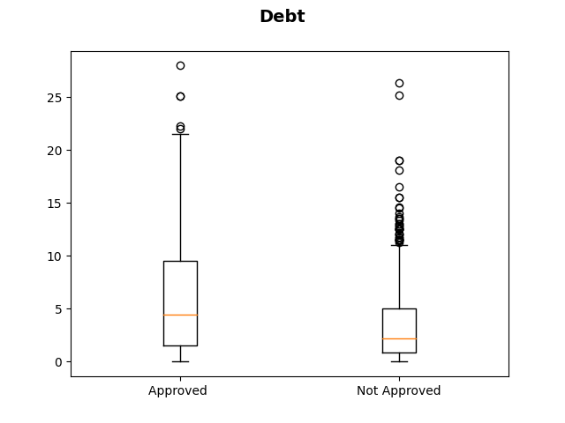
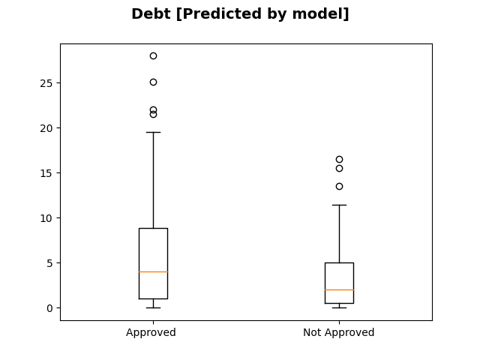
Visualization of the Results
Box Plot (Training Dataset)
Box Plot (Testing Dataset)

Slide 27
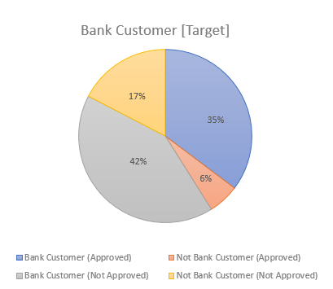
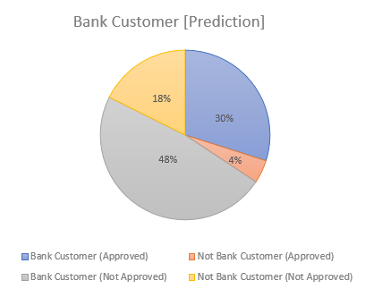
Visualization of the Results
Bank Customer | Approved | Not Approved
1 (has a bank account) | 73 | 86
0 (has no bank account) | 12 | 36
Bank Customer | Approved | Not Approved
1 (has a bank account) | 61 | 98
0 (has no bank account) | 9 | 39
Bank Customers

Slide 28
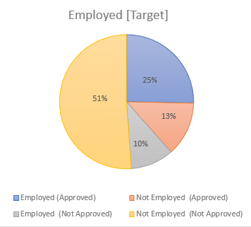
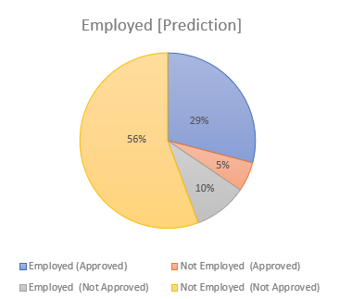
Visualization of the Results
Employed | Approved | Not Approved
1 (Is employed) | 56 | 23
0 (Is not employed) | 29 | 99
Bank Customer | Approved | Not Approved
1 (Is a bank customer) | 59 | 20
0 (Is not a bank customer) | 11 | 117
Employed

Slide 29
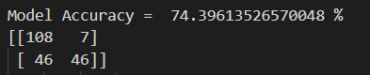
Added Discussion
Accuracy when Age and Gender have added

Slide 30
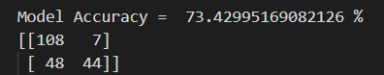
Added Discussion
Accuracy when Gender was added

Slide 31
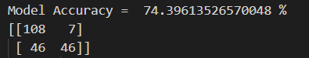
Added Discussion
Accuracy when Age was added

Slide 32
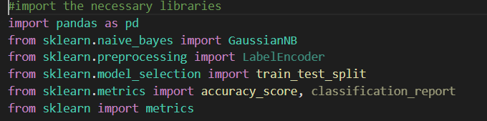
Snippet of Codes
Important libraries

Slide 33
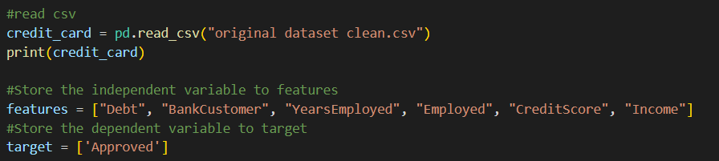
Snippet of Codes
Read CSV, Features and Target

Slide 34
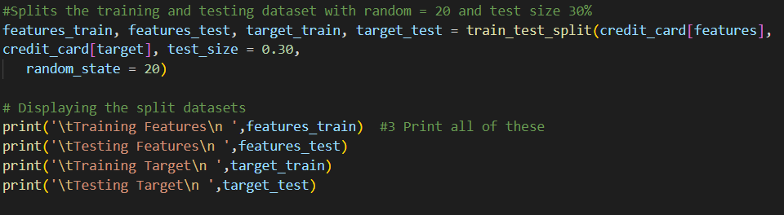
Snippet of Codes
Data Splitting

Slide 35
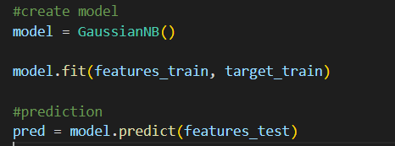
Snippet of Codes
Model and Prediction

Slide 36
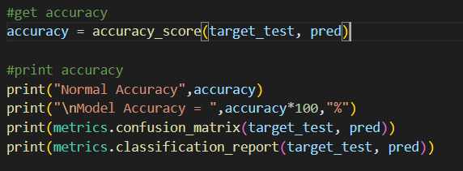
Snippet of Codes
Getting the accuracy

